Slide 1

PRAGUE DEPARTMENT PROJECT
CREATED BY: Michal Uhrinek

Slide 2


WHAT WAS THE REASON TO CREATE THIS?
I WAS CURIOUS HOW IS OUR TEAM DOING
IN WEEK
DAY
MONTH
PTS CURR
PTS BULK
OVERALL
OUR SUCCESS RATE
WRONG PROCESSED TASKS RATE ( NOT A ERRORS BUT TASKS)

Slide 3
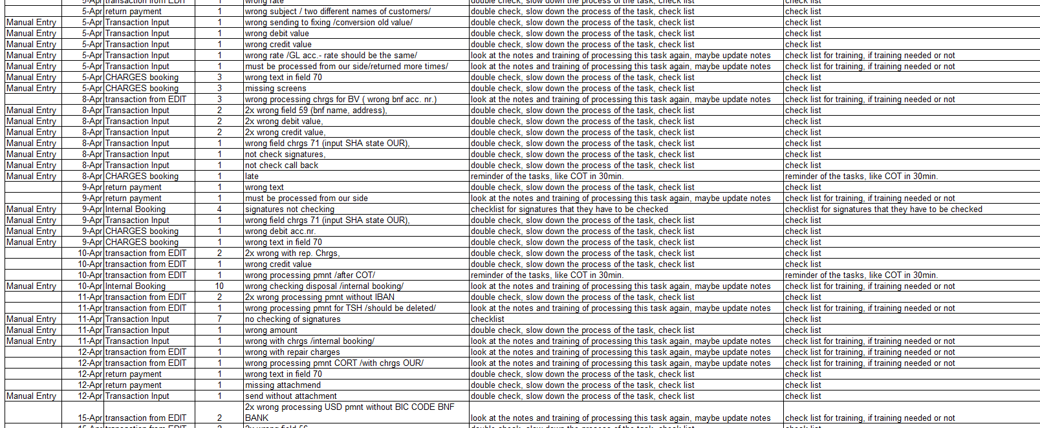
MESSY DATA BEFORE

Slide 4
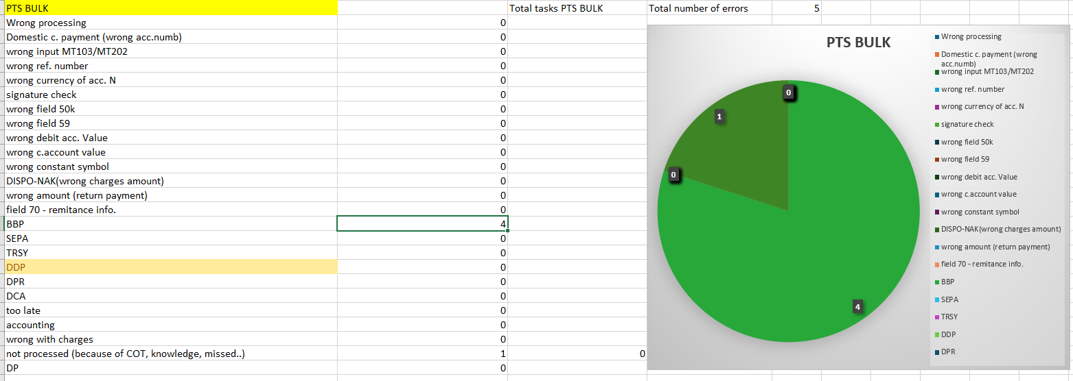
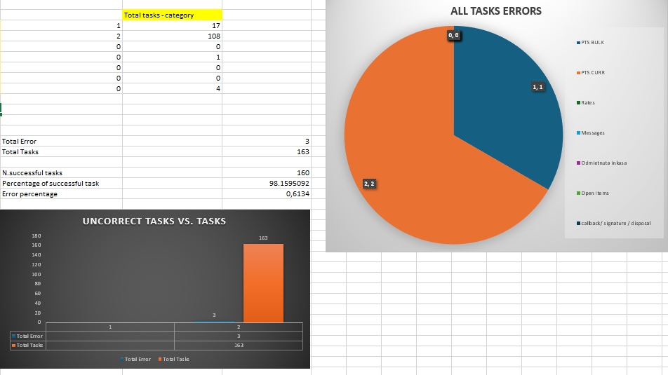
DATA NOW

Slide 5

WHAT IS THIS SYSTEM?
It is an easy way of collecting data about employee, team and their performance - (Analytical tracking tool).
What we can achieve?
We can measure
success rate,
wrong processed tasks rate
category of mistake/task
volume rate
type of a mistake
volume
On personal level or
group level within day, week, month.

Slide 6




HOW DOES THE SYSTEM SOLVE THE PROBLEM?
BY TRACKING THE VOLUME OF TASKS, WRONG TASKS ON DAILY BASIS WE CAN MANAGE TO SEE WHERE THE TEAM OR EMPLOYEE STRUGGLE THE MOST.
We can easily identify the mistakes and choose a proper strategy to avoid repeating them. We can ask for additional training or pair him/her with colleague who know this tasks better.

Slide 7
SO HOW DOES IT WORK?

Slide 8

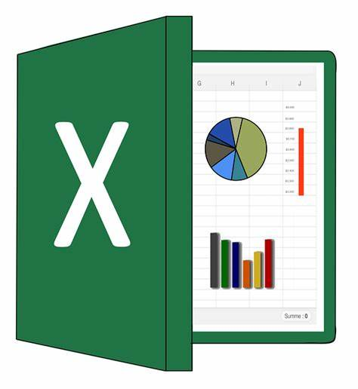





DATA FLOW
Daily data collection on personal level
Elan
In the end of the week Mike will take data to process them.
Why should we do it?
We can monitor the department
or employee progress.
If anyone need extra training and where?
KPI of an employee
Its easy to use, access, fast, no brainer.
Does not require additional resources
If Prague wants to call on us about some mistakes, we can show them our stats as a prove.
Michal
Nasrul
Monthly stats of the person
Team monthly stats
Renee

Slide 9
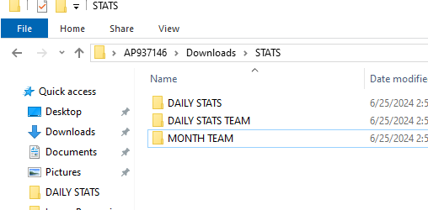
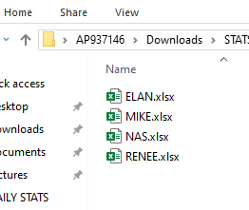
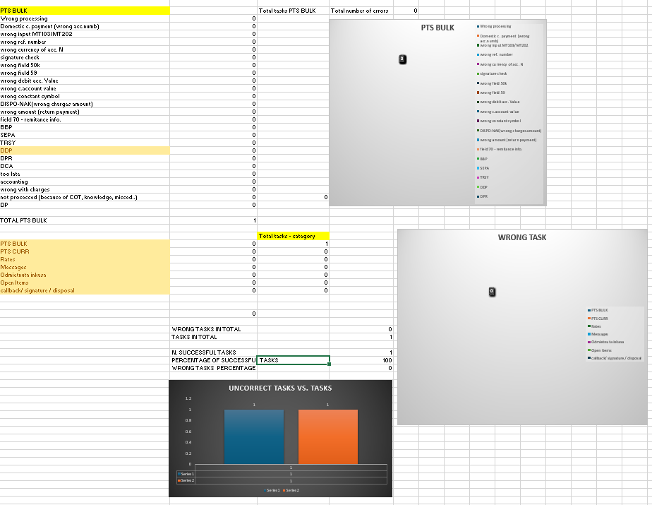
FILE ORGANIZATION
In the beginning of the shift employee just copy and paste a excel sheet of himself.
Then he/she continue inputting data in it.
This way we have new sheets per day per person.

Slide 10
WHY DO WE NEED TO KEEP TRACK OF VOLUME FOR DIFFERENT TASKS?
Imagine scenario:
Monday Tuesday Wednesday Thursday Friday
Task volume: 10 50 500 50 120
Error: 1 3 4 5 6

Slide 11
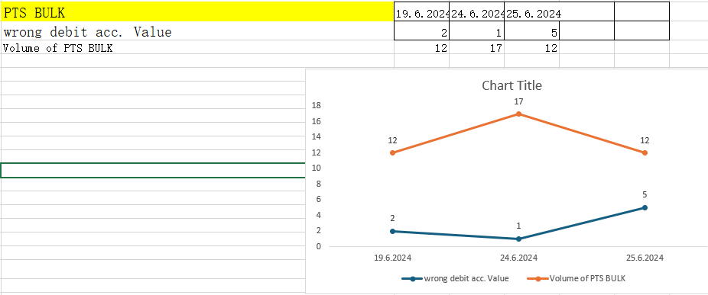
IS THERE A WAY TO TRACK PTS CURR OR SPECIFIC ERROR OVER TIME ?
Yes, it is and here you can trace any type of error or volume or application like PTS CURR over time.
Time needed for tracking any part of process over time in team or separately takes about – 5 -10min.

Slide 12



WHAT WILL HAPPEN IF WE DON’T IMPLEMENT THIS SYSTEM?
THE WHOLE DEPARTMENT WILL COLLAPSE
PROGRESS WILL KEEP FALLING
IT WILL BE A MESS WITH NOT KNOWING
WHAT WE DO WELL AND WHAT WE DONT

Slide 13
THANK YOU

